Slide 1


Pimpri Chinchwad Education Trust’s Pimpri Chinchwad College of Engineering Nigdi Pune-
Web Development
HSMC - Professional Skills for Engineers
Second Year – B Tech
Name - Suraj Sudam Dalvi
Roll No - SYCOA044
Div - A
Dept of Computer Engineering

Slide 2
Contents
Web Vs App
Basic Terms in website
How Website Works ?
Website 3 Components Architecture
Frameworks
Types of Developers
HSMC
English - 1 Dr Sandeep Patil

Slide 3
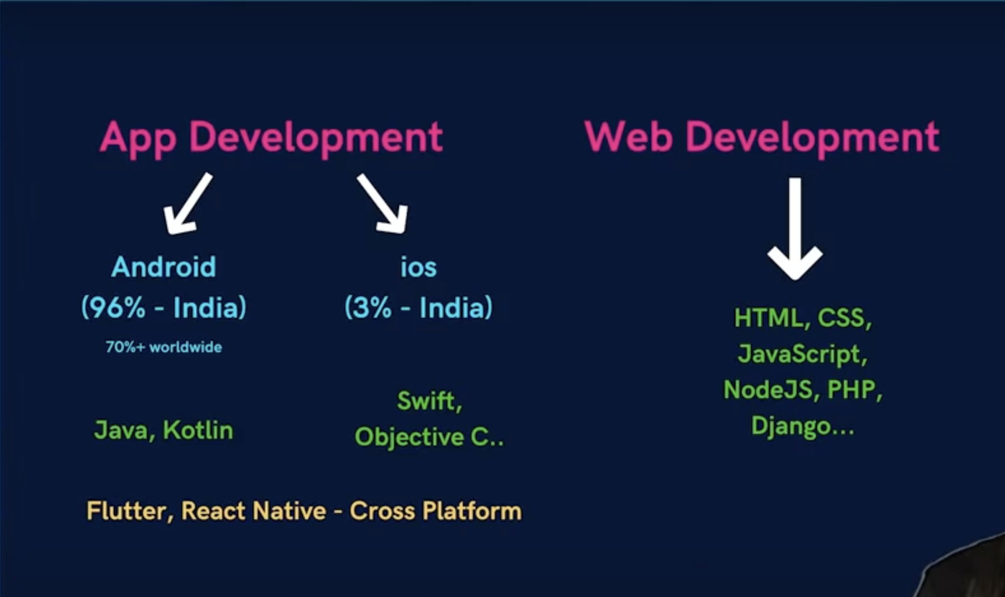
Web Vs App
HSMC
English - 1 Dr Sandeep Patil

Slide 4
Basic Terminologies
Link : https://www.mongodb.com
client and server
URL
www
http vs https
IP Address
HSMC
English - 1 Dr Sandeep Patil

Slide 5
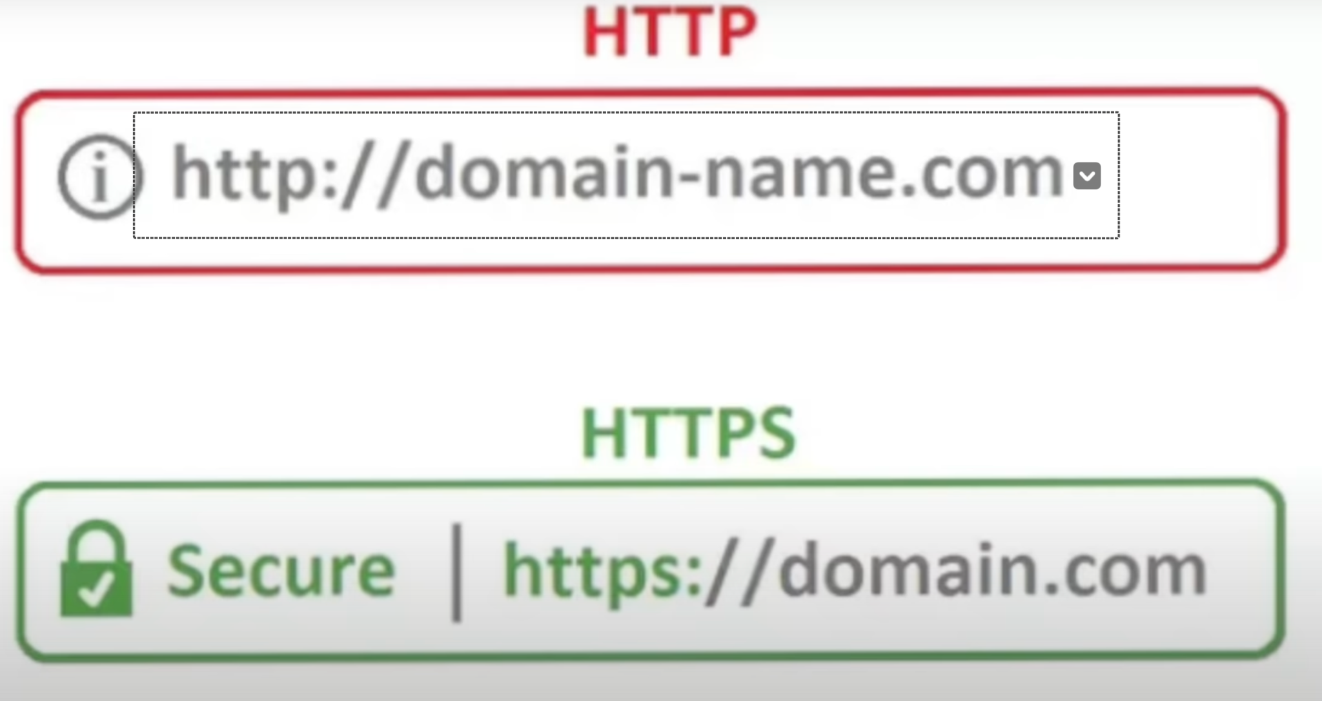
HTTP vs HTTPS
HSMC
English - 1 Dr Sandeep Patil

Slide 6
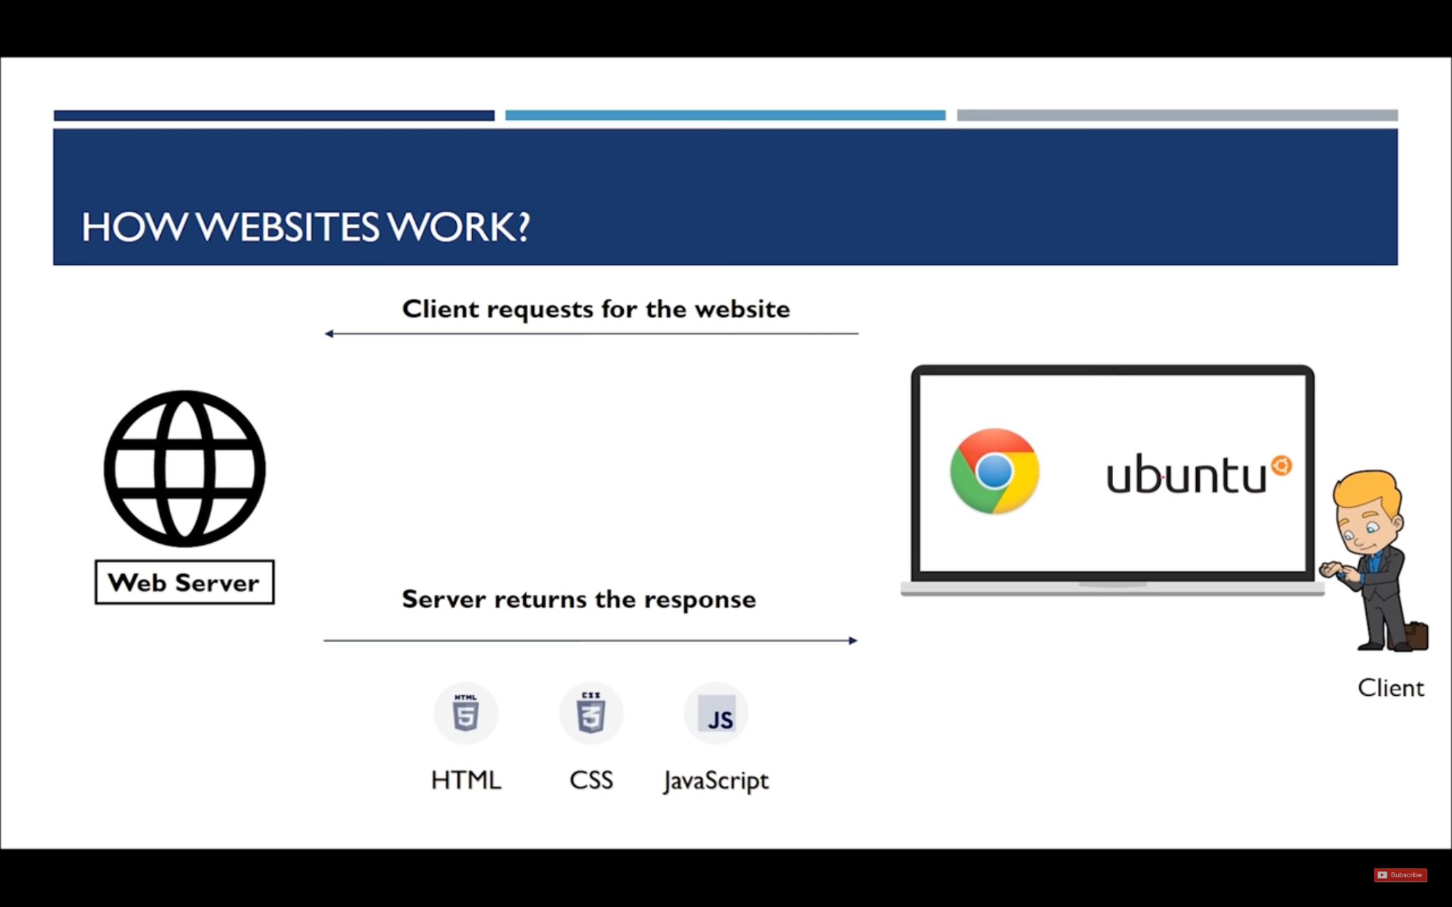
How Website Works…?
HSMC
English - 1 Dr Sandeep Patil

Slide 7
Website 3 Components Architecture
Frontend
Backend
Database
HSMC
English - 1 Dr Sandeep Patil

Slide 8
Website 3 Components Architecture
Website
Three components
Front End Back End Database
User Interface (UI) background collection of data
Algorithm
Required (main source code
frameworks of the website) Required
framework
1. HTML (Skeleton) 1. PHP
2. CSS (Design) 2. Django 1. MySQL 2. MongoDB
3. JS (Logic) 3. NodeJS
HSMC
English - 1 Dr Sandeep Patil

Slide 9
Frameworks
Frontend Frameworks
Backend Frameworks
Database Frameworks
HSMC
English - 1 Dr Sandeep Patil

Slide 10
Types of Developers
Frontend Developers
Backend Developers
Full Stack Developers
MERN Stack Developers
MEAN Stack Developers
HSMC
English - 1 Dr Sandeep Patil

Slide 11
THANK YOU !
HSMC
English - 1 Dr Sandeep Patil

